Slide 1
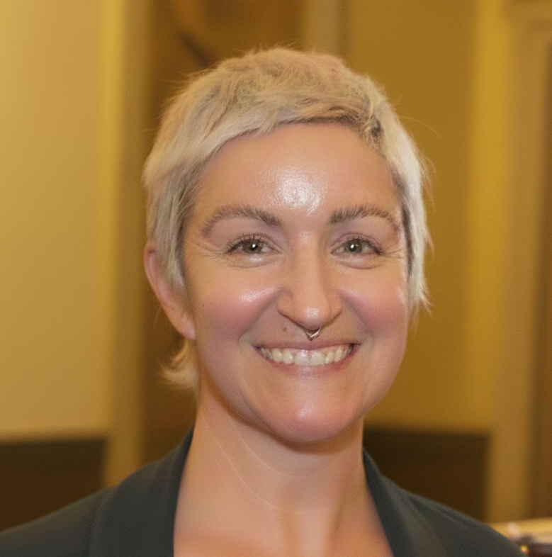

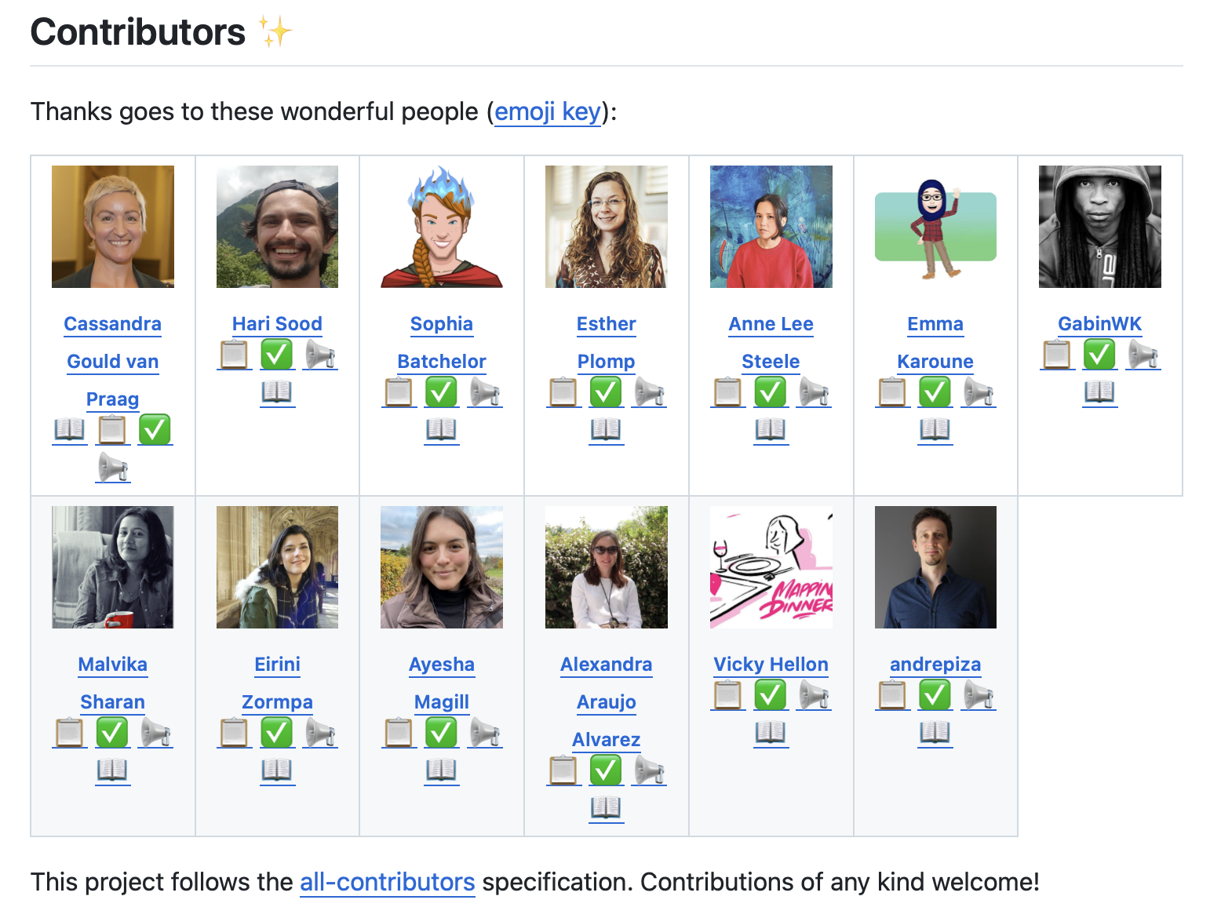
Git Good
an Introduction to GitHub for Collaboration
Cassandra Gould van Praag
Executive Director, RCM Cooperative
TOSI Open Scientist in Residence 2025
Emma Karoune
Principle Researcher, Alan Turing Institute
Co-Founder, RCM Cooperative
All illustrations by Scriberia for The Turing Way
used under CC-BY 4.0 License
This template has been created by Slidesgo

Slide 2
Housekeeping
Slides and list of links available at:
https://github.com/the-turing-way/gitgood
Recording: Camera off / chat if you don’t want to be attributed
Add questions to zoom chat
Use raise hands to speak and use zoom reactions to let us know when you have finished an activity
We are operating under the McGill Faculty of Medicine and Health Sciences Code of Conduct
“…demonstrate respect and appreciation for [your] colleagues…”
https://www.mcgill.ca/medhealthsci/about/our-vision-mission-values/code-conduct
See Appendix 1 for reporting procedures
You will need a GitHub account to follow along with the tutorials
Make one now if you haven’t got one already!
All exercises will use the online GitHub interface
Does not require git to be installed or security set up
Julia Pfarr (ORIGAMI Lab) Git/Hub 101 at Mtl BrainHack 2026:
https://julia-pfarr.github.io/git-gitlab_tutorial/
Kendra Oudyk (ORIGAMI Lab) Intro to Git/GitHub OSHO Feb 2025
https://www.youtube.com/@OpenScienceOfficeHours

Slide 3
Aims
Feel more confident in:
Interacting with GitHub;
Contributing to other peoples GitHub materials;
Setting up your own repositories to receive contributions;
Know where to find help with any of this!
Agenda
Part 1: What is Git & Github?
Exercise 1: Finding an Issue and contributing to a project
You will practice: Using issues to contribute and document decisions, markdown
Part 2: What is open source?
Part 3: Using GitHub online and in the terminal (demo)
Exercise 2: Editing a file and making a Pull Request
You will practice: Markdown; contributing, pull requests
Part 4: What can we make with Github? (Websites and Project Management)
Exercise 3 (take home): Make your own website

Slide 4
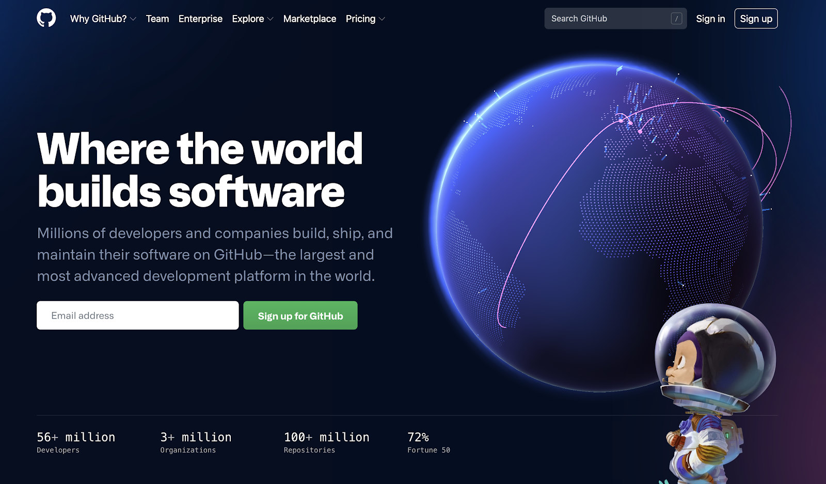
What is GitHub?
Sounds like it’s only for programmers!
GitHub is also great for version control of anything with letters/numbers/characters (and images) in and even better for working collaboratively!
GitHub enables:
Making and sharing of something which looks professional
Tracking of changes as your project grows
Integration of contributions from others
Maintenance of an open “To Do” list
Licensing and DOI’ing materials, making them reusable and citable

Slide 5






Git vs GitHub
Software which enables for version control.
Free and open source!
Often pre-installed on your computer
A popular service for hosting and sharing projects you have been tracking with git.
Secure and flexible control of access to materials.

Slide 6
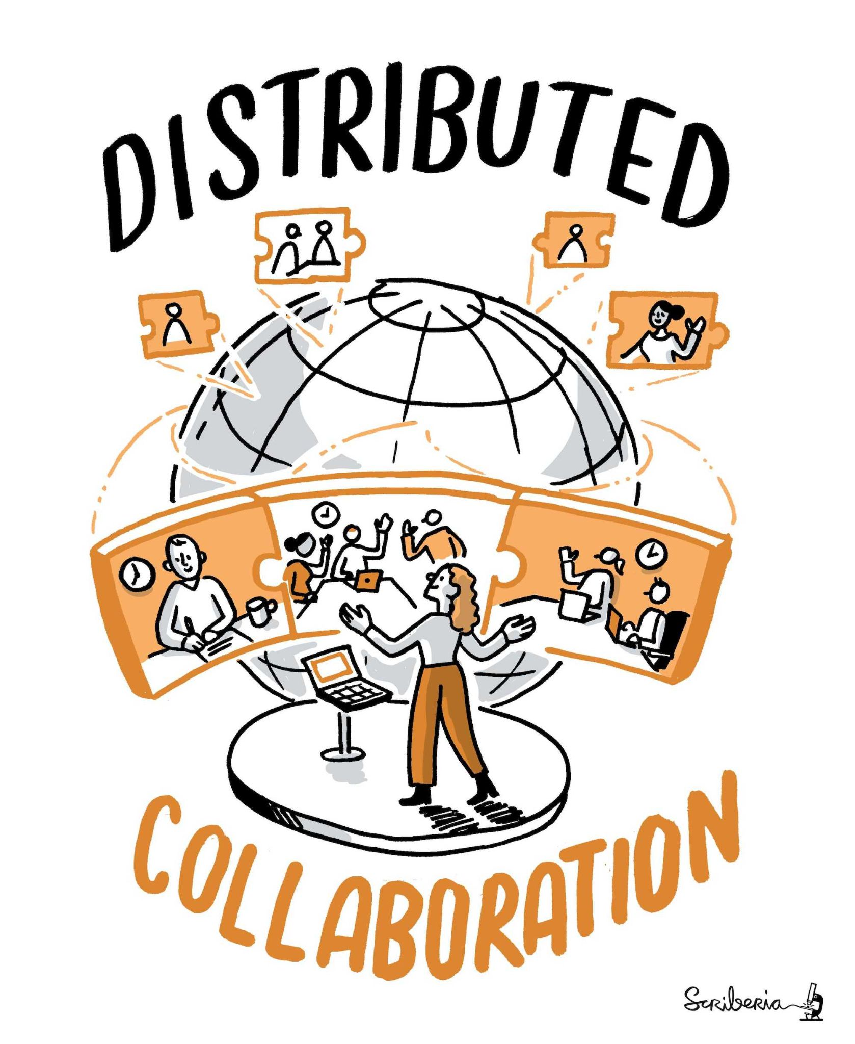
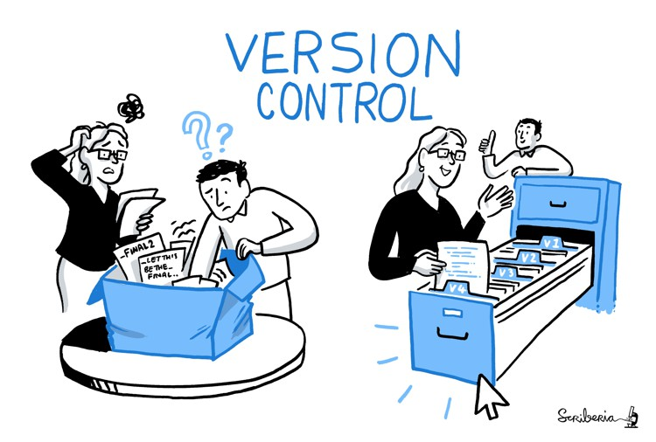
Collaborative docs
Multiple people contributing to the same information from different times/places.
Hand/Chat: What might be challenges with distributed collaboration?
Hand/Chat: How could version control help?

Slide 7
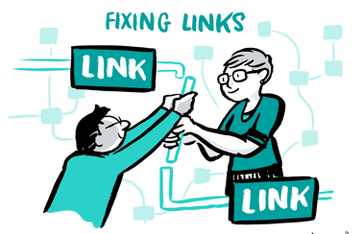
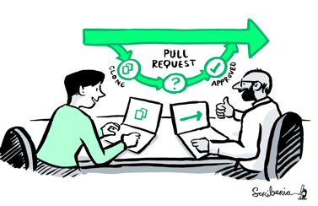
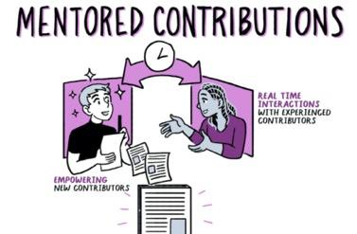
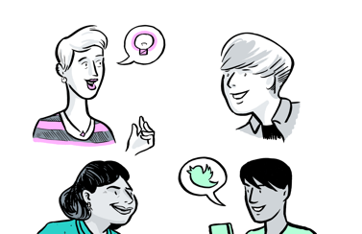
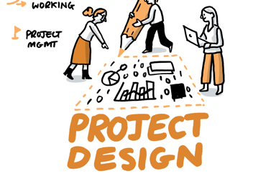
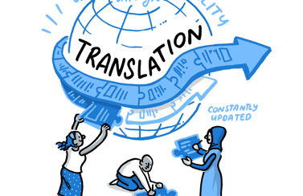
Making distributed collaboration possible
Version control
Reviewing & updating
Attribution to contributors
Transparency & accountability
Project management
Share globally

Slide 8
Navigating
Files:
README
CONTIBUTING
CODE_OF_CONDUCT
LICENSE
Issues
Pull requests
Projects
Contributors
File views:
Preview
Code
Blame
History
Commits
Diff
Repo vs organization
Organisation members
Repo collaborators
Chat: Any buttons you want to see or understand?

Slide 9
Exercise 1: Commenting
Go to the practice space repo issues and complete issue #3
Take a look at the markdown cheat sheet to add some formatting to your comment
Use zoom reaction ✅ when you are done
Collaboration practice!

Slide 10
Discussion
What are the pros and cons of using a platform like GitHub for:
Your own code and documents?
Shared (private) code and documents?
Shared (public) code and documents?
What are your questions?
Hands / Chat

Slide 11
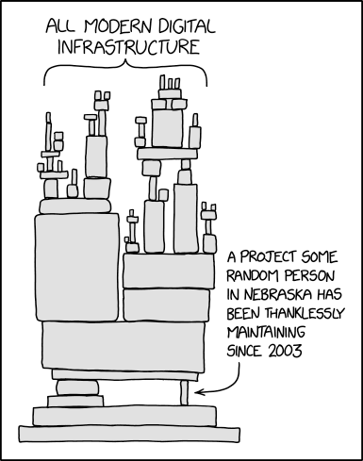
Part 2: Open Source
Chat: What open source software do you use?
xkcd, ‘Dependency’: https://xkcd.com/2347/
Open Source Initiative (OSI) Legal definition:
The software is free to redistribute
The source code is included
"Derived works" (remixes) are allowed
There is no discrimination against persons, groups, or fields of endeavour (e.g., you cannot ban a specific company or country from using it)
Roots in free software movement
Developed into free and open source software (F/OSS) movement
Influenced other ‘open’ movements: open knowledge, open data, open access, open science

Slide 12
Why do we need licenses?
The Legal Default is "Closed"
By international copyright law, any original work (code, text, or data) is automatically protected by "All Rights Reserved" the moment it is created.
If you put materials on GitHub without a license, other researchers can look at it, but they cannot legally download, run, or build upon it.
A license tells the world, "I own this, but I am giving you legal permission to use it under these specific conditions."
Safeguarding "Safe Sharing"
Researchers often hesitate to share because they fear their work will be used in ways they didn't intend. Licenses create a contract.
Liability Protection: Almost all open licenses include a "Disclaimer of Warranty." which protects you from being sued if someone else uses your code and it fails or produces an error.
Credit as The Currency of Academia
Academia runs on citation and reputation.
In traditional publishing, we have established norms for citing papers. For code and documentation, licenses like MIT or CC-BY turn "attribution" from a polite suggestion into a legal requirement.
By licensing your "non-paper" outputs (datasets, software, tutorials), you are forcing the academic ecosystem to treat those contributions as valuable, citable objects.

Slide 13
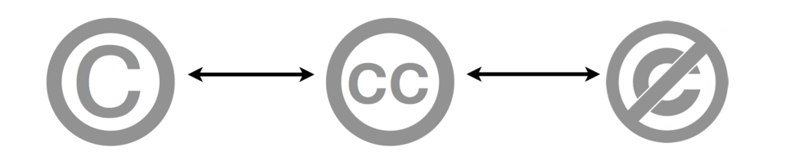
Licenses & copyright
Copyright
All Rights Reserved
Reuse requires the permission from the copyright owner
Open License
Some Rights Reserved
Re-use is permitted without permission under the specific limitations of the license
Public Domain
No Rights Reserved
May be used without permission
Permissive Licenses
"You can do whatever you want with this, as long as you give me credit (attribution) and don't hold me liable.”
Examples: MIT, Apache 2.0, BSD, CC-BY-4.0
Good: Encourage maximum adoption. No issues with IP or license stacking
Bad: Changes can be relicensed as closed
Copyleft (reciprocal) Licenses
“If you use my open materials, you must make your derived materials open too”
Examples: GNU GPL (v2 or v3), AGPL, CC-BY-SA
Good: Prevents enclosure of the commons
Bad: Hesitancy to force openness
Go look for a software license

Slide 14
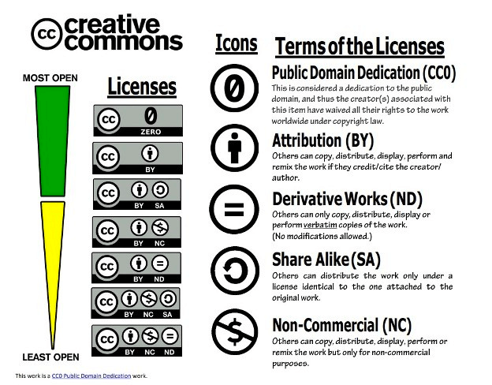
Licenses for docs
When you publish in Neuroimage, you are asked to choose form one of Elsevier’s approved “open access user licenses”:
Creative Commons Attribution (CC BY)
Creative Commons Attribution-NonCommercial (CC BY-NC)
Creative Commons Attribution-NonCommercial-NoDerivatives (CC BY-NC-ND)
Copyright Elsevier or a Society
Elsevier user license
Which is most / least permissive?
Ohio State University, CC0

Slide 15
Licenses for docs
Why do docs have different licenses than code?
"Software" vs. "Literary Works"
Code Licenses (MIT, GPL): are designed for functional works. They deal with things like "compilation," "object code," and "execution.”
Creative Commons (CC): Are designed for literary and artistic works. They cover "reproduction," "adaptation," and "display.”
Most code licenses don't explicitly address the rights needed for documentation, such as the right to translate a book into another language or the right to print and sell physical copies.
The "Attribution" Problem
In the MIT license, the requirement is to keep the "copyright notice and permission notice" in all copies of the software (LICENSE.md)
In documentation, CC-BY gives you more flexibility on how you give credit (e.g., a "Credits" page or a footer).
Using MIT for a book might legally require you to print the entire MIT license text on every single page or diagram.
How would you like your research outputs to be licensed?

Slide 16
Licenses for hardware
Follow similar permissive < > copyleft spectrum
The "Right to Manufacture"
”Copying" involves buying components, soldering, and assembly.
A hardware license gives you the legal right to manufacture a physical version of the design.
Without a hardware-specific license, someone might have the right to look at your circuit diagram (protected by copyright), but they might not technically have the right to build and sell the physical item if the "utility" isn't covered by the license.
The Patent "Safety Net"
Copyright protects how ideas are written down. Patents protect how things work.
If you share a new sensor design under a documentation license, a company could file a patent on the "invention," and then sue you for making your own device.
Licenses like CERN-OHL or Solderpad include "Patent Grants." This means anyone who contributes to the project effectively says: "I promise not to sue anyone for using any patents I have that are part of this design."
The "Physical" Attribution
Hardware licenses often include clauses about "Notice Retention" on the physical object.
Hardware licenses specify where/how the license is identified on the physical item.

Slide 17
Summary slide
🌞 🏝️ 🕶️ 🍉 ☀️ ⛱️ 🌞 🏝️ 🕶️ 🍉 ☀️ ⛱️
We want to share our work so our research can have the greatest impact!
Sharing on GitHub enables the use of a well tested mechanism to receive the input of others
More contributions been more robust and potentially more impactful
Contributions are attributed and version controlled
When we share, we should always apply a license so we can control how our outputs are used on by whom.
Licenses can be more or less restrictive
Software documentation and hardware all have specific license types which legal terms appropriate to different outputs
🌞 🏝️ 🕶️ 🍉 ☀️ ⛱️ 🌞 🏝️ 🕶️ 🍉 ☀️ ⛱️

Slide 18
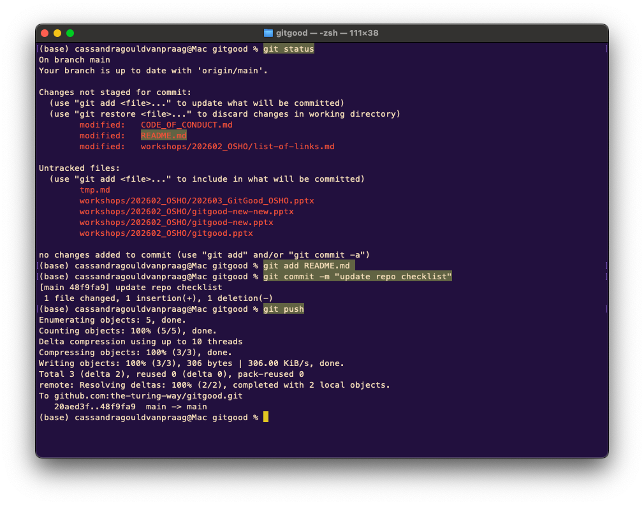
Part 3: Using GitHub
For some repos you might have a ‘local’ copy on your computer and a ‘remote’ copy on GitHub
Personally, I have a local copy where I want to do more complicated editing
Pushing your local changes to your remote
Directory must first be initialised for git (ready to be tracked)
> git status
> git add [filename]
> git commit –m “[describe the change]”
> git push

Slide 19
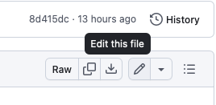

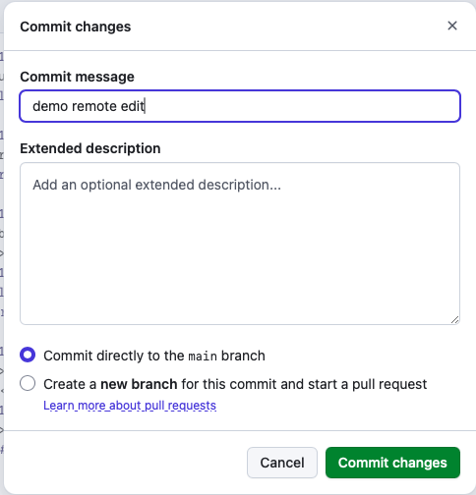
Editing online
Making online changes to your remote
Find the file
<Edit this file>
Make the change
<Commit changes>

Slide 20
Collaborating on someone else's repo
Make a copy of their repo (fork)
Make your changes in your online copy (commit)
Share your changes with the repo owner (pull request)
Changes are incorporated in the original repo (merge)
Additional step of making your own copy of the repo preserves the fidelity of the original and give you space to play!
We’re going to practice this online only!

Slide 21

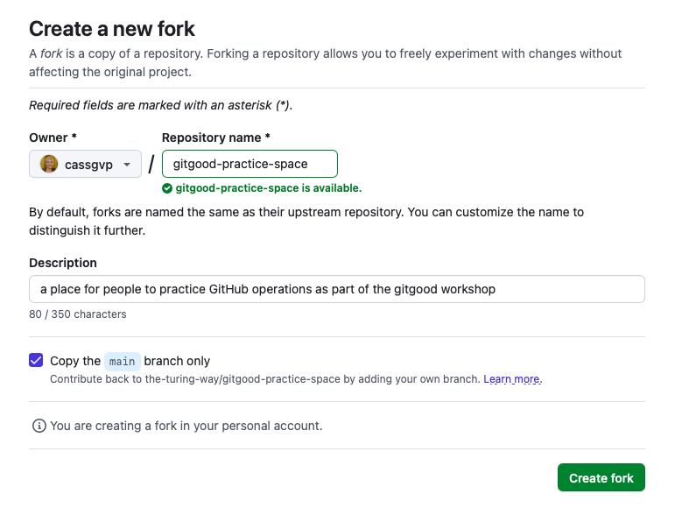
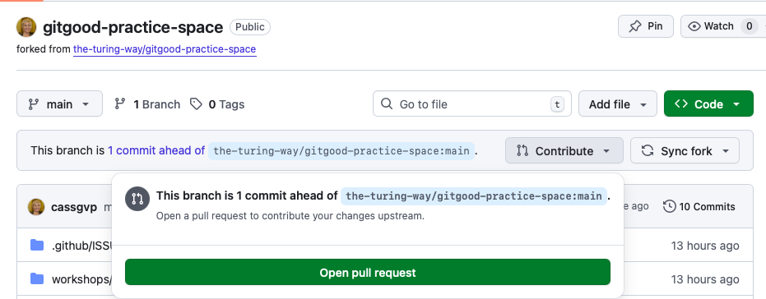
Collaborating on someone else's repo
Make a copy of their repo (fork)
Make your changes in your online copy (commit)
Share your changes with the repo owner (pull request)

Slide 22
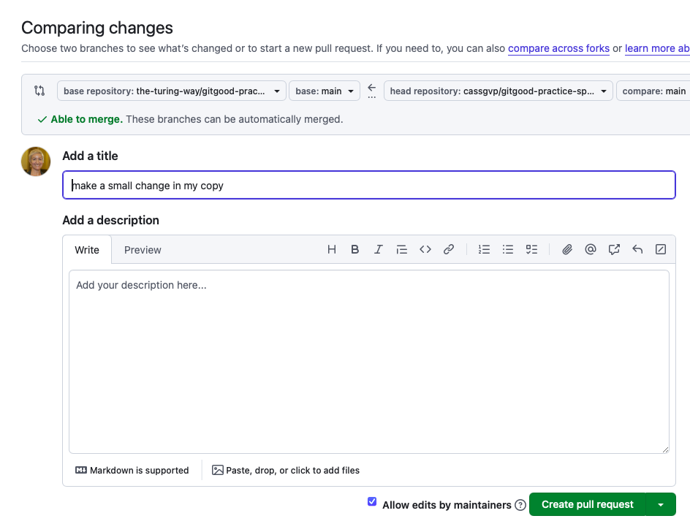
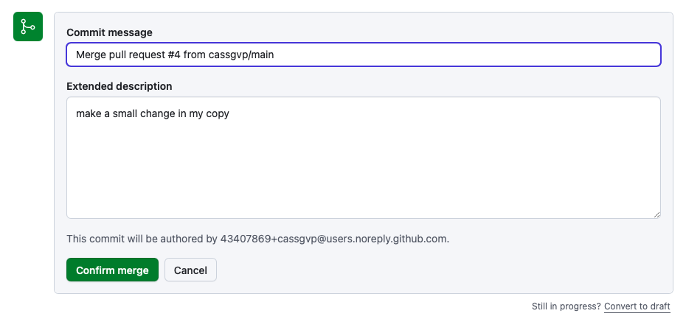
Collaborating on someone else's repo
Changes are reviewed by repo original repo owner (merge)

Slide 23
Exercise 2: Pull request
We’re all going to submit a pull request to the practice repo!
Choose a line to edit from the framapad
Make a copy of the practice repo (fork)
Add your name; date today; a link to your research profile or some of your work to exercise-2.md (commit)
Share your changes with the repo owner (pull request)
Emma will review and incorporate your changes (merge)
Use zoom reaction ✅ when your changes have been merged!
We’ll look out for any accident merge conflicts to review together
Collaboration practice!

Slide 24
🎉
You submitted a pull request!

Slide 25
Discussion
What are your fears / concerns about working on someone else’s repo?
How would you like people to interact with you / your repos? (CONTRIBUTING.md)
What are your questions?
Hands / Chat

Slide 26
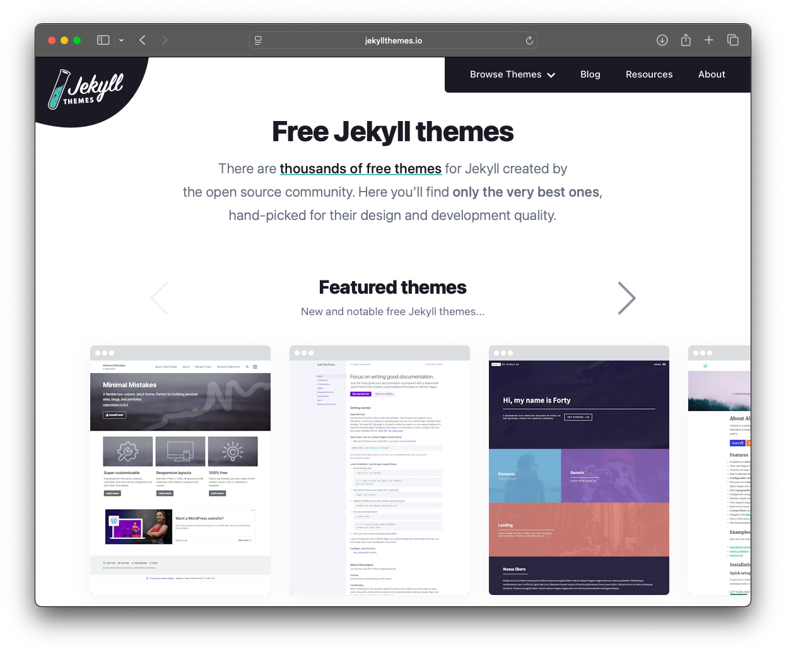
Part 4: What else can you do with GitHub
GitHub Pages (github.io)

Slide 27
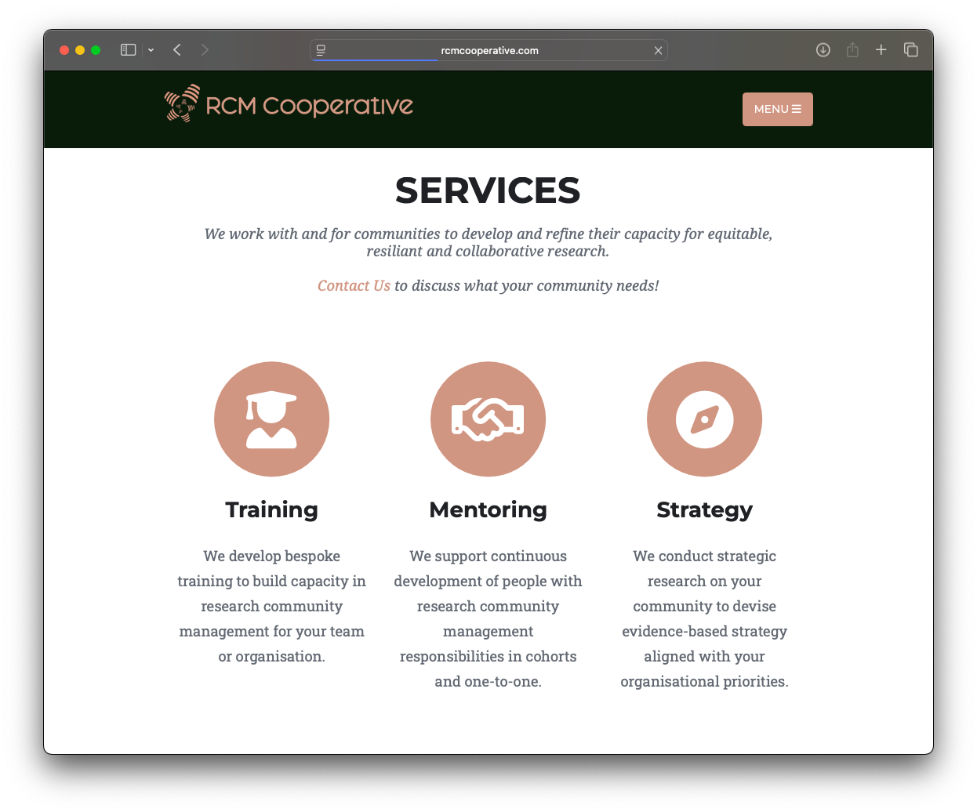
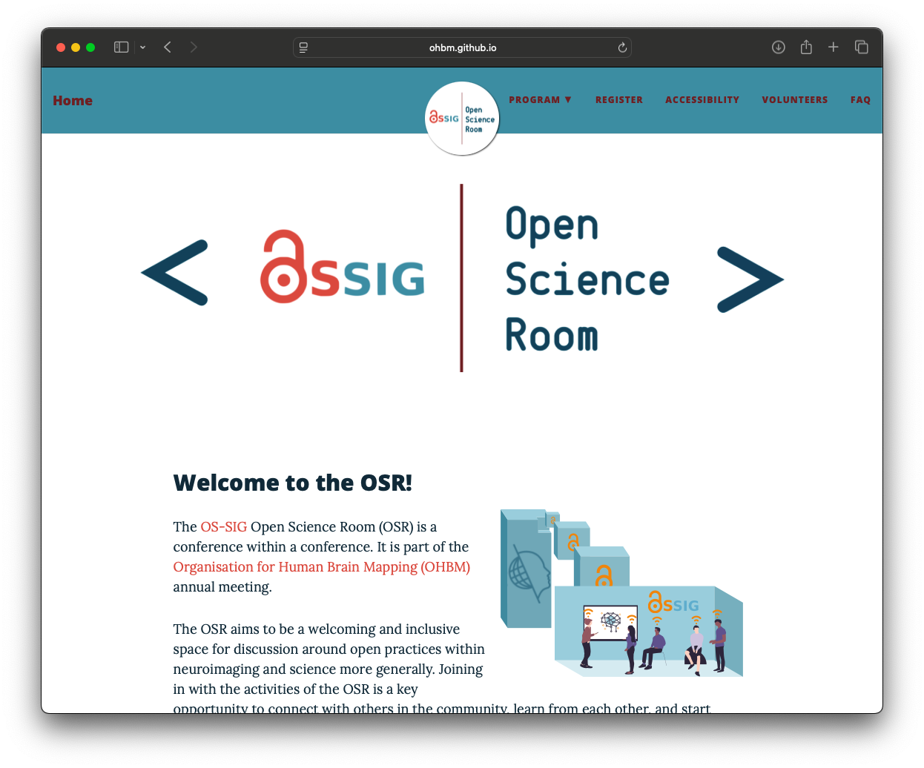
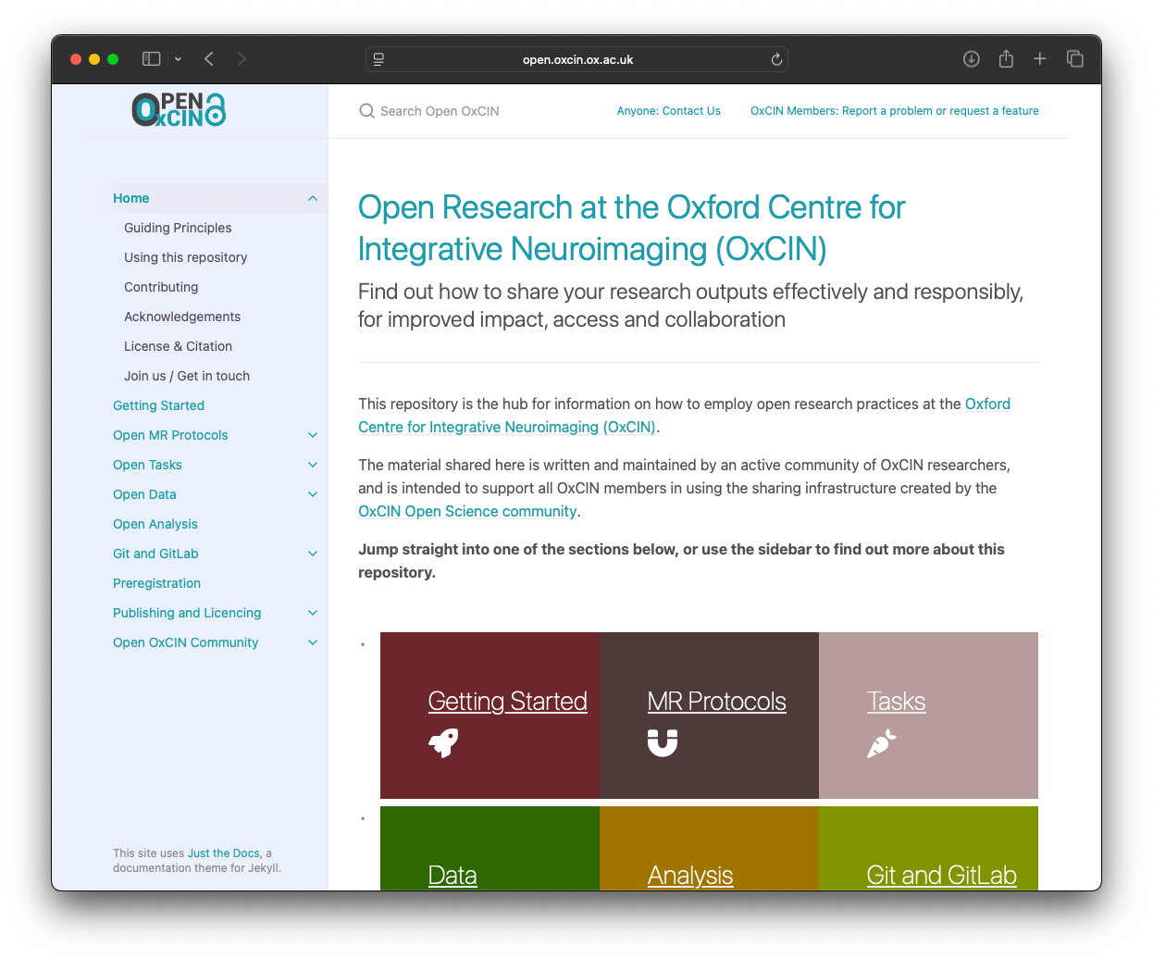
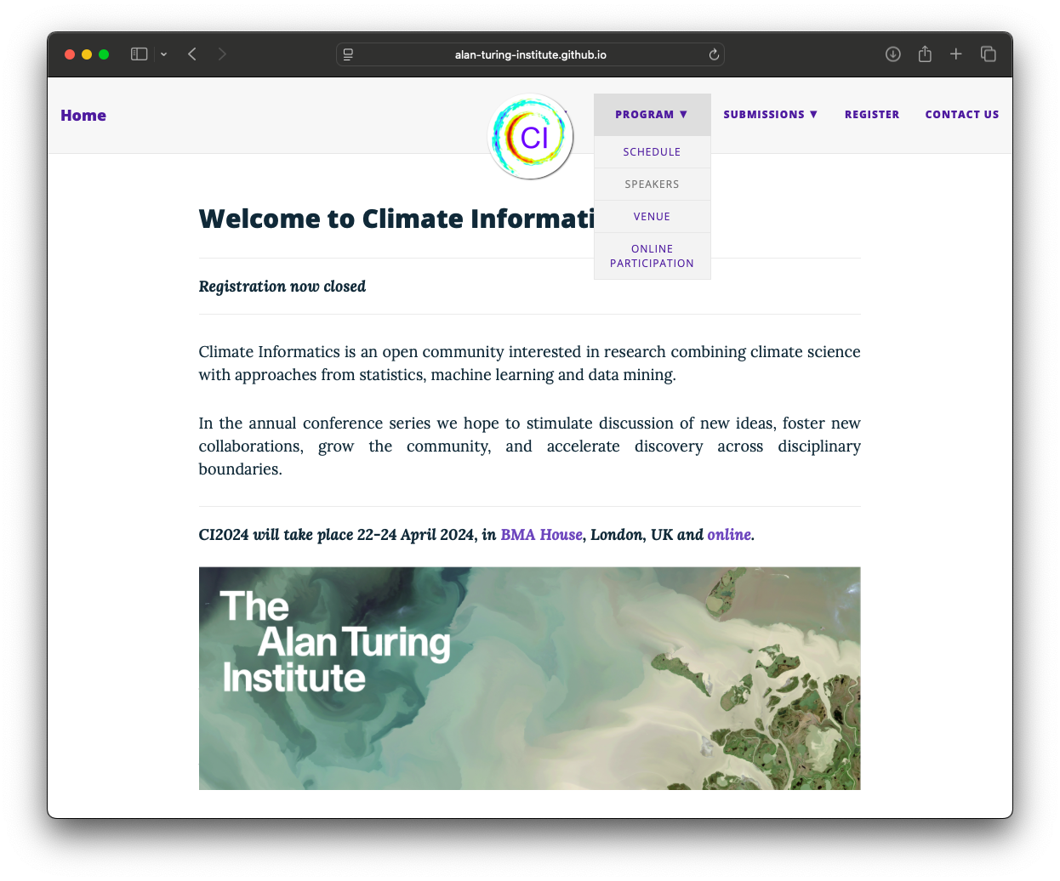
GitHub Pages
Collaborative, version controlled, reproducible!

Slide 28
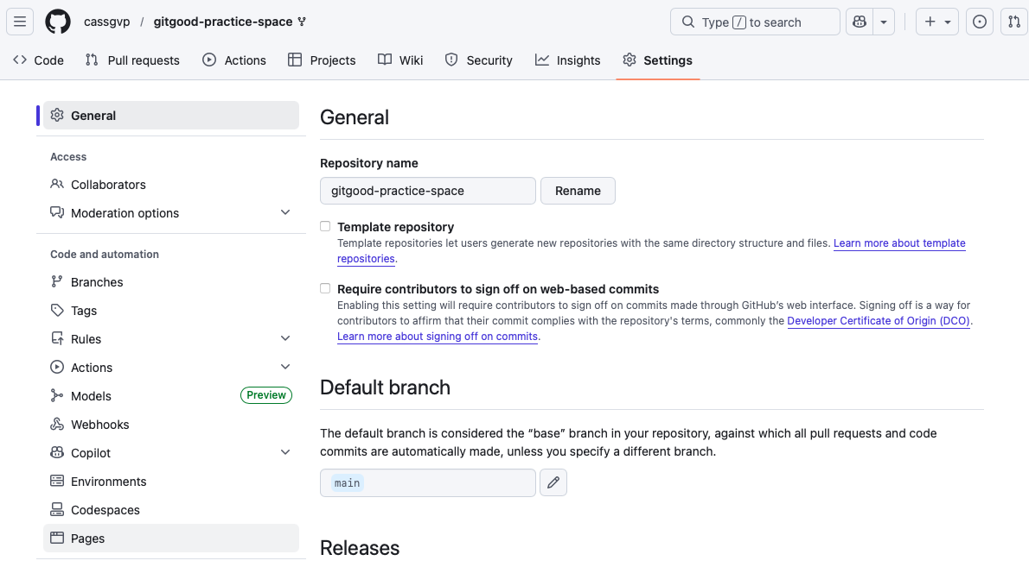
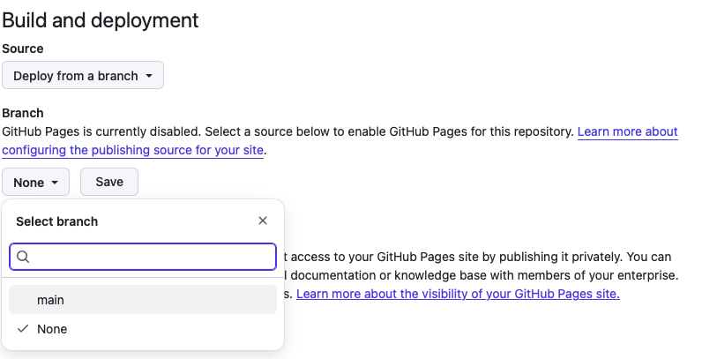
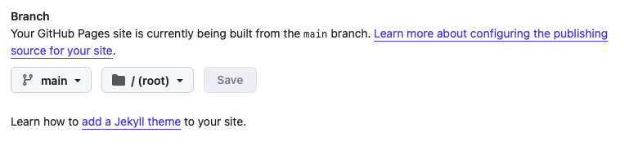
GitHub Pages
Enable Pages
Choose a branch
Apply a (remote) theme

Slide 29
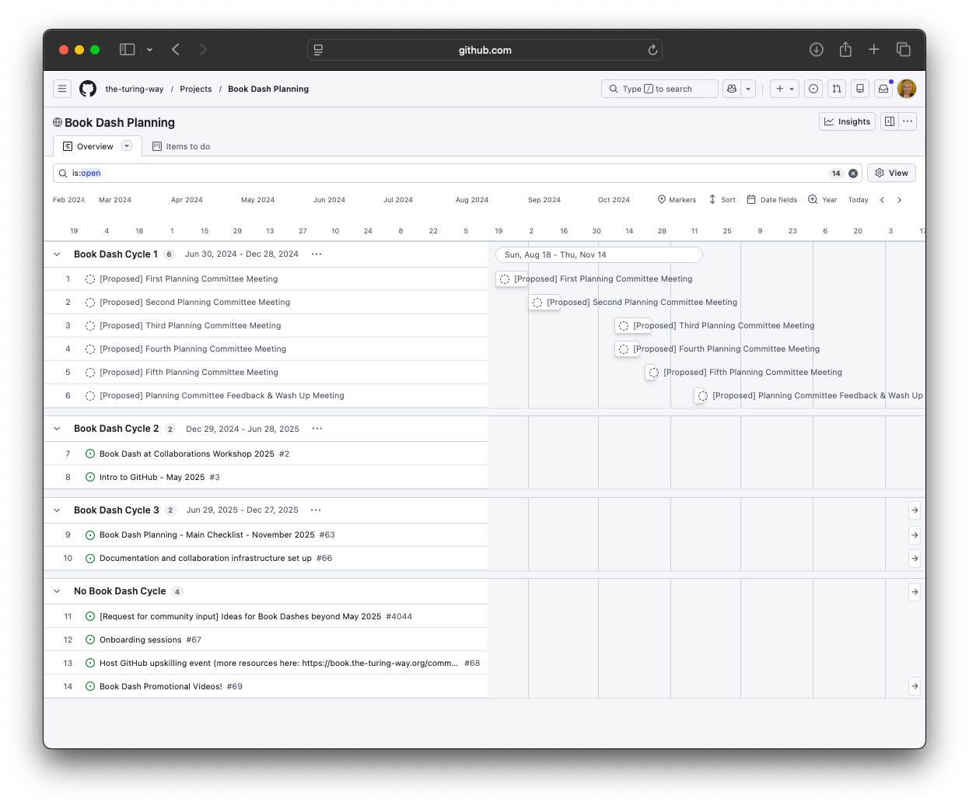
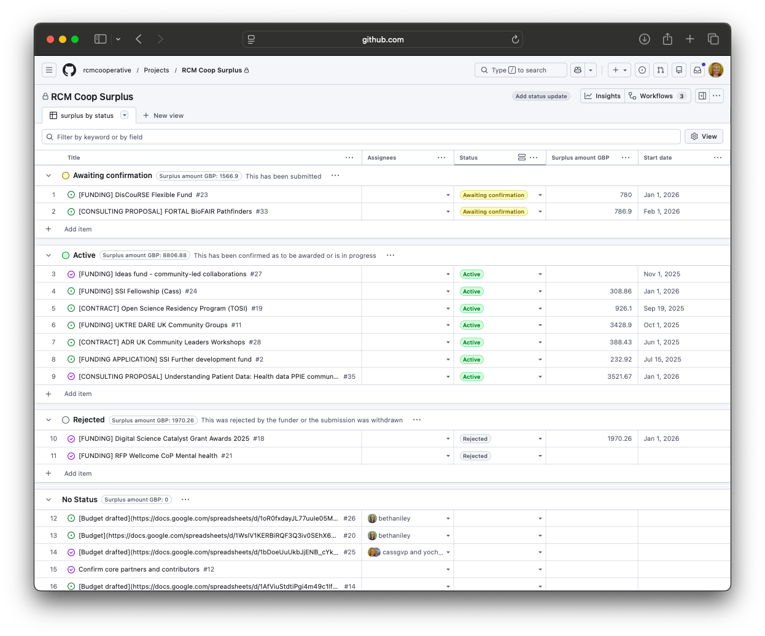
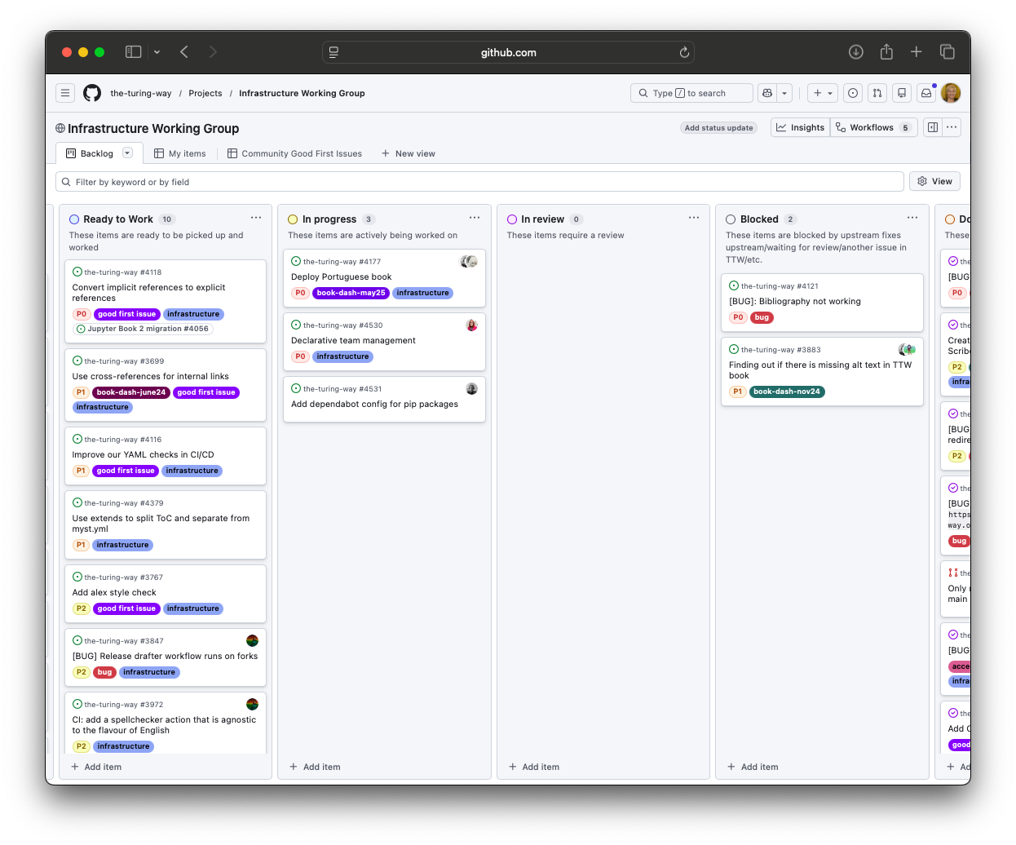
Project Management

Slide 30
Discussion
What are you going to try next with GitHub?
What are your questions?
Please fill in the feedback form now 😊
Hands / Chat

Slide 31
Summary slide
🌞 🏝️ 🕶️ 🍉 ☀️ ⛱️ 🌞 🏝️ 🕶️ 🍉 ☀️ ⛱️
We want to share our work so our research can have the greatest impact!
Sharing on GitHub enables the use of a well tested mechanism to collaborate with attribution
We know why and how to license our materials
We know how to submit and receive contributions
We know that we can publish collaborative webpages with GitHub
We know that GitHub can be used to manage collaborative projects
🌞 🏝️ 🕶️ 🍉 ☀️ ⛱️ 🌞 🏝️ 🕶️ 🍉 ☀️ ⛱️

Slide 32
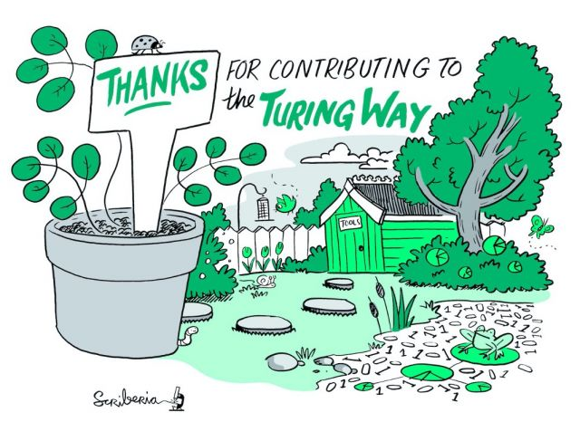
Closing
Thanks to TTW GitGood contributors and TTW infrastructure team!
Thanks to OSHO for brining us together!
Thank you for engaging!
Book time with Cass to discuss anything related to this workshop, open science / reproducibility, collaboration / research community management!

